Slide 1
CSE101-Lec#2
Structured Programming Using Algorithm and Flowchart(or Program development tools)

Slide 2
Outline
Structured programming using
Algorithm and
Flowchart
or
Program development tools

Slide 3
Program Development Tools
Algorithm
Flowchart

Slide 4
Algorithm
Algorithm is defined as “ the finite set of steps, which provide a chain of action for solving a problem”
It is step by step solution to given problem.
Well organized, pre-arranged and defined textual computational module

Slide 5
Characteristics of good Algorithm
Correctness - terminates on ALL inputs (even invalid inputs!) and outputs the correct answer.
Simplicity - each step of the algorithm performs one logical step in solving the problem.
Precision - each step of the algorithm is unambiguous in meaning.
Comprehensibility - the algorithm is easy to read and understand.
Abstraction - presents the solution steps precisely and concisely without referring to low-level (program code) details.
Efficient - Gives results rapidly based on the problem size; does not waste any space or time.
Easy to Implement - relatively easy to translate into a programming language.

Slide 6
Steps to create an Algorithm
1. Identify the Inputs
What data do I need?
How will I get the data?
In what format will the data be?
2. Identify the Outputs
What outputs do I need to return to the user?
What format should the outputs take?

Slide 7
Steps to create an Algorithm
3. Identify the Processes
How can I manipulate data to produce meaningful results?
Data vs. Information
4. Break the Solution to steps
By breaking the solution to the steps we can easily understand the logic of program

Slide 8
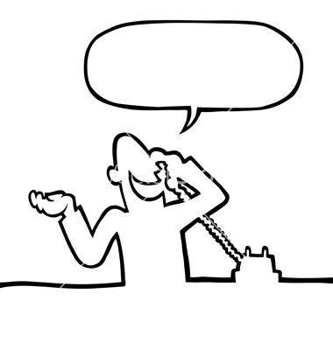
General example of Algorithm
To establish a telephone communication
Step 1: Dial a phone number
Step 2: Phone rings at the called party
Step 3: Caller waits for the response
Step 4: Called party picks up the phone
Step 5: Conversation begins between them
Step 6: After the conversation, both disconnect the call

Slide 9
Algorithm: Add 2 Numbers[Example 1]
Step 1: Start
Step 2: Declare variables num1, num2 and sum.
Step 3: Read values num1 and num2.
Step 4: Add num1 and num2 and assign the result to sum.
sum←num1+num2
Step 5: Display sum
Step 6: Stop

Slide 10
Algorithm: Calculate area of circle[Example 2]
Step 1: Start
Step 2: Declare variables radius and area.
Step 3: Read value of radius.
Step 4: Apply the expression as specified below and assign the result in area
area←3.14*radius*radius
Step 5: Display area
Step 6: Stop

Slide 11
Algorithm: Swap the values of two variables[Example 3]
Step 1: Start
Step 2: Declare three variables: num1,num2 and temp
Step 3: Read values of num1 and num2
Step 4: Assign the value of num1 in temp
temp ←num1
Step 5: Assign the value of num2 in num1
num1 ←num2
Step 6: Assign the value of temp in num2
num2 ←temp
Step 7: Display swapped values of num1 and num2
Step 8:Stop

Slide 12
Practice questions for Algorithms
Write an algorithm to calculate and display simple interest and final amount
Write an algorithm to swap the values of 2 numbers without using temporary variable
Write an algorithm to convert temperature from degree Celsius to degree Fahrenheit and vice versa
Write an algorithm to multiply, divide and subtract two numbers and display their individual results
Write an algorithm to read the prices and quantities of 5 items and display the final amount after applying a discount of 10 percent
Write an algorithm to convert distance from km to m and vice versa
Write an algorithm to display the areas of triangle, square and rectangle and display their individual results.

Slide 13
Q1
Which of the following characteristic is not desired in good algorithm?
A. Ambiguity
B. Correctness
C. Simplicity
D. Abstraction

Slide 14
Q1
Which of the following characteristic is not desired in good algorithm?
A. Ambiguity
B. Correctness
C. Simplicity
D. Abstraction

Slide 15
Q2
Q2:Algorithm is:
A. Infinite set of steps
B. Pictorial representation
C. Textual Computational solution
D. Actual Code for the solution

Slide 16
Q2
Q2:Algorithm is:
A. Infinite set of steps
B. Pictorial representation
C. Textual Computational solution
D. Actual Code for the solution

Slide 17
Q3
Q3.Efficient algorithm is one which takes
A. Less time
B. Less space
C. More time and space
D. Both A and B options

Slide 18
Q3
Q3.Efficient algorithm is one which takes
A. Less time
B. Less space
C. More time and space
D. Both A and B options

Slide 19
Flow Chart
Flow Chart is pictorial representation of an algorithm.
Whatever we have done in algorithm we can represent it in picture.
It is easy to understand.
Shows the flow of the instruction

Slide 20
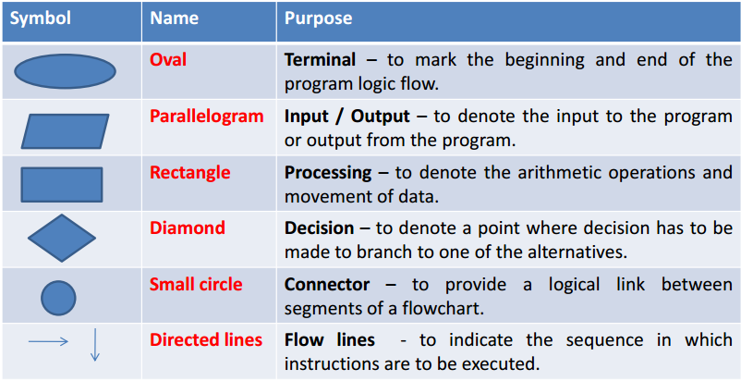
Flow Chart Symbols

Slide 21
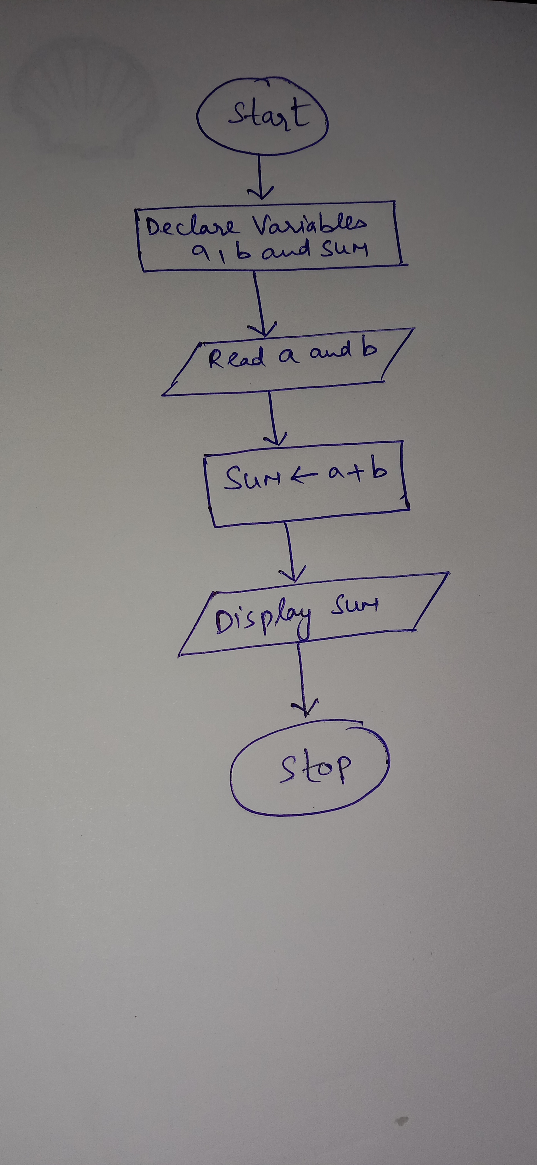
Flowchart Example 1-Adding 2 numbers

Slide 22
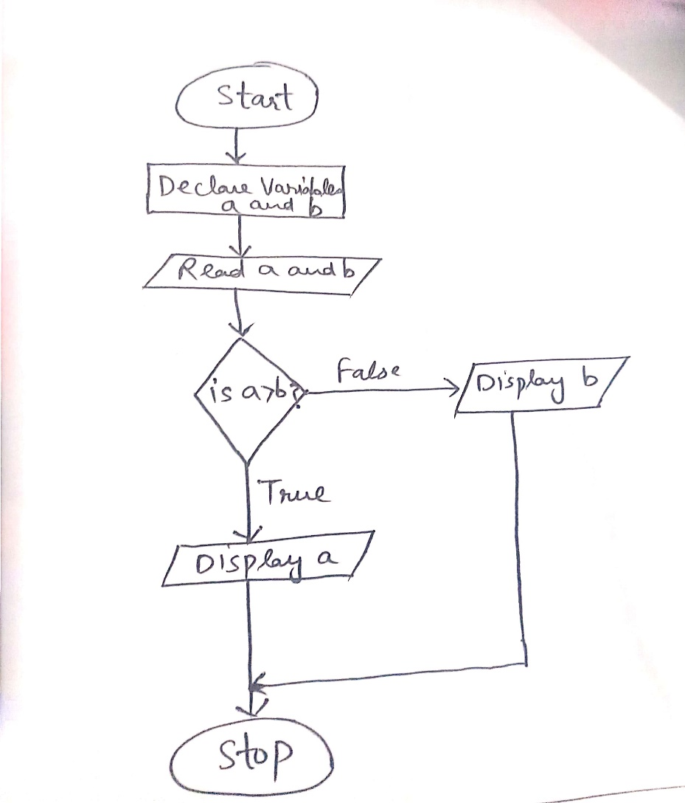
Flowchart Example 2-Displaying greatest of 2 numbers

Slide 23
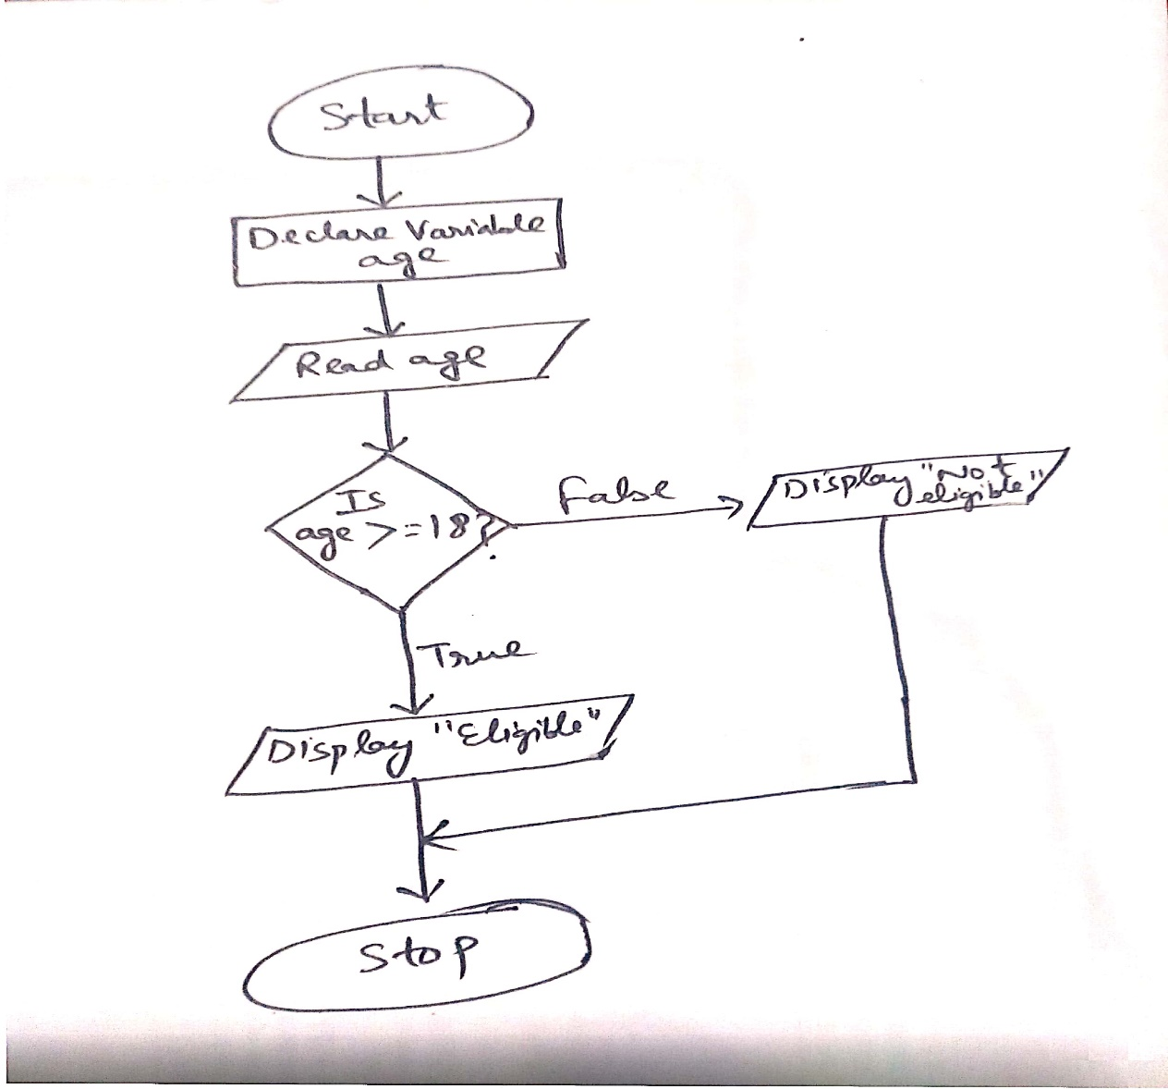
Flowchart Example 3-Checking whether a person is eligible to vote or not

Slide 24
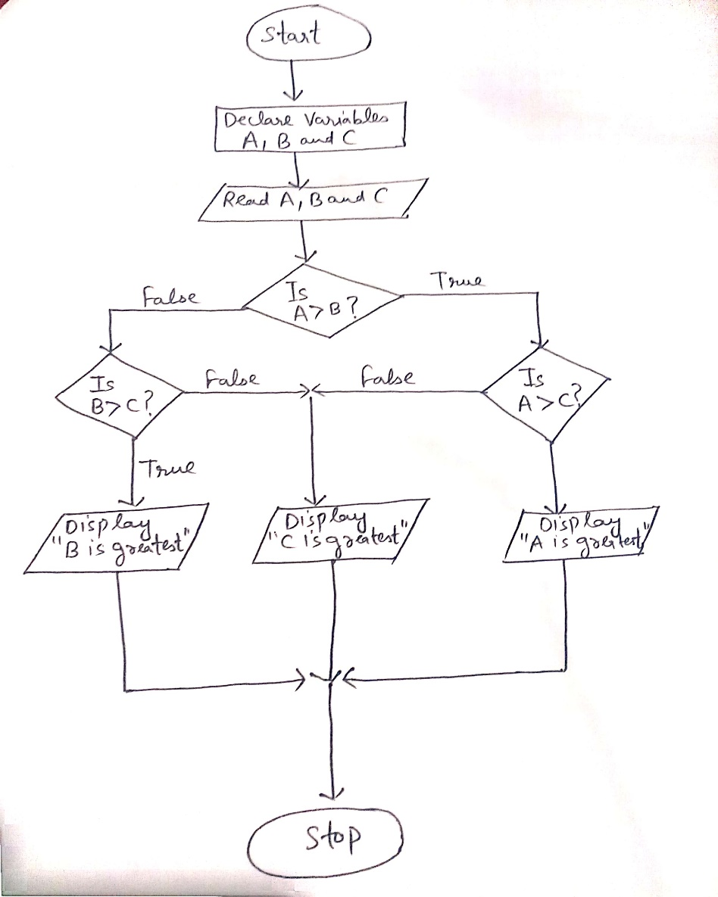
Flowchart Example 3-Greatest of 3 numbers

Slide 25
Practice questions for flowcharts Write solutions using RAPTOR and without RAPTOR(Basic conventions)
Draw a flowchart to check whether a given number is even or odd
Draw a flowchart to calculate simple interest and final amount
Draw a flowchart to calculate the area of a circle
Draw a flowchart to display the roots of a quadratic equation
Draw a flowchart to check whether the given number is a multiple of 5 or not
Draw a flowchart to swap the values of two variables without the help of temporary variable

Slide 26
Q1
Which of the following symbol is used to denote decision or condition in a flowchart?
Oval
Rectangle
Diamond
Small Circle

Slide 27
Q1
Which of the following symbol is used to denote decision or condition in a flowchart?
Oval
Rectangle
Diamond
Small Circle

Slide 28
Q2
Oval symbol in a flowchart is used to represent
Input/Output
Decision
Connector
Start and Stop

Slide 29
Q2
Oval symbol in a flowchart is used to represent
Input/Output
Decision
Connector
Start and Stop

Slide 30
Q3
Which of the following symbol is used to denote processing part in a flowchart?
Oval
Rectangle
Diamond
Parallelogram

Slide 31
Q3
Which of the following symbol is used to denote processing part in a flowchart?
Oval
Rectangle
Diamond
Parallelogram

Slide 32
More practice questions on Flowchart Write solutions using RAPTOR and without RAPTOR(Basic conventions)
1) Draw a flowchart to calculate circumference of circle
2) Draw a flowchart to display the equivalent grade student has achieved after calculating the percentage of marks in 5 subjects[A+,A,Fail]
3) Draw a flowchart to calculate the area of triangle, cylinder and rhombus
4) Draw a flowchart to calculate the compound interest

